Slide 1
CLICK SHOPPING

Slide 2
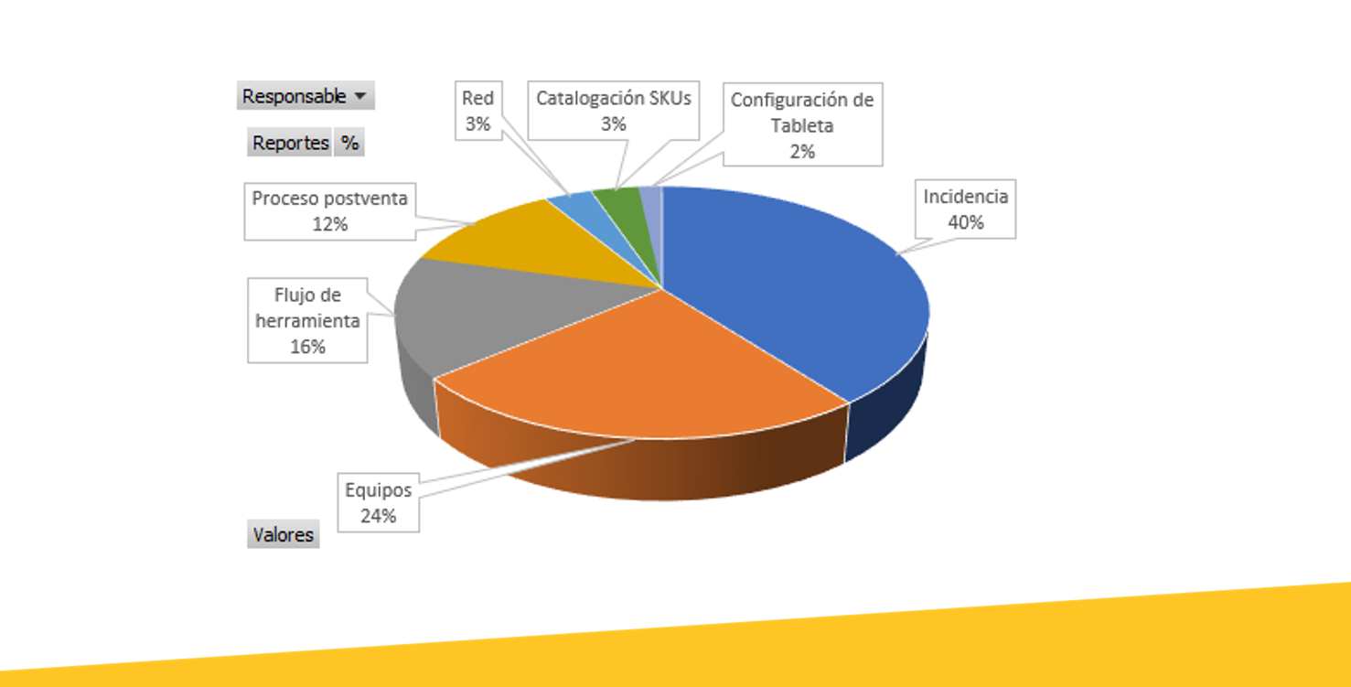
CLICK SHOPPING

